Slide 1
PROJECT LOAN MANAGEMENT SYSTEM
Presented by
A.Sai Suvish Reddy

Slide 2
DATA SETS:-
Customer Income Status
Loan Status
Customer Info
Country State
Region Info

Slide 3
Sheet - 1
Import table from sheet 1- customer income status
set customer criteria based on applicant income
Criteria
Applicant income >15,000 = grade a
Applicant income >9,000 = grade b
Applicant income >5000 = middle class customer
Otherwise low class
(Create this as new table)

Slide 4
Query:-
Use suvish
select * ,case
when applicantincome>15000 then "a grade“
when applicantincome>9000 then "b grade“
when applicantincome>5000 then "middle class customer“
else "low class“
end as results
from customer_income_status;

Slide 5
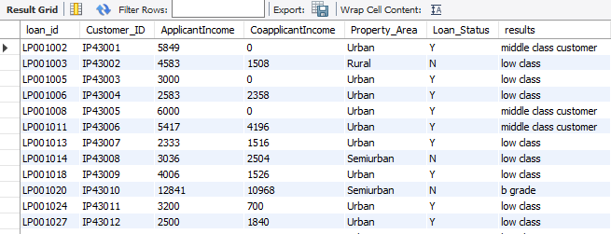
Output:-

Slide 6
Sheet 2 - loan status
Create row level trigger for loan amt
Criteria:-
Loan amt null = loan still processing
Query:-
create table loan_status(Loan_ID varchar(50),Customer_id text ,LoanAmount varchar(50),Loan_Amount_Term int,Cibil_Score int,primary key(loan_id));
CREATING TRIGGER:-
delimiter !!
create trigger loan_update before insert on loan_status for each row
Begin
if new.loanamount is null then set new.loanamount="loan still processing";
end if;
end!!
delimiter ;
Create statement level trigger for cibil score
Criteria
Cibil score >900 high cibil score
Cibil score >750 no penalty
Cibil score >250 penalty customers
Cibil score <=0 reject customers (loan cannot apply)
Then delete the reject and loan still processing customers
Update loan as integers
Create all the above fields as a table
Table name - loan cibil score status details

Slide 7
INSERTING VALUES INTO TABLE :-
insert into loan_status values
('LP001002','IP43001',Null,360,303),
('LP001003','IP43002',128,360,920),
('LP001005','IP43003',66,360,606),
('LP001006','IP43004',120,360,851),
('LP001008', 'IP43005',141,360,420),
('LP001011','IP43006',267,360,173),
('LP001013','IP43007',95,60,650),
('LP001014','IP43008',158,360,471);

Slide 8
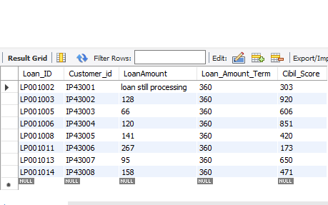
OUTPUT :-
select * from loan_status;

Slide 9
Create statement level trigger for cibil score
Criteria :-
Cibil score >900 high cibil score
Cibil score >750 no penalty
Cibil score >250 penalty customers
Cibil score <=0 reject customers (loan cannot apply)
Then delete the reject and loan still processing customers
Update loan as integers
Create all the above fields as a table
Table name - loan cibil score status details

Slide 10
QUERY:-
delimiter $$
create trigger loan_update2 after insert on loan_status for each row
Begin
if new.cibil_score>900 then
insert into loan_cibil_score_status_details(loan_id,loanamount,cibil_score,cibil_score_status) values (new.loan_id,new.loanamount,new.cibil_score,"high_cibil_score");
elseif new.cibil_score>750 then
insert into loan_cibil_score_status_details(loan_id,loanamount,cibil_score,cibil_score_status) values (new.loan_id,new.loanamount,new.cibil_score,"No_Penalty");
elseif new.cibil_score>250 then insert into loan_cibil_score_status_details(loan_id,loanamount,cibil_score,cibil_score_status) values (new.loan_id,new.loanamount,new.cibil_score,"Penalty_customers");
elseif new.cibil_score<=0 then insert into loan_cibil_score_status_details(loan_id,loanamount,cibil_score,cibil_score_status) values (new.loan_id,new.loanamount,new.cibil_score,cibil_score_status,"rejected_customers");
end if;
end $$
delimiter ;

Slide 11
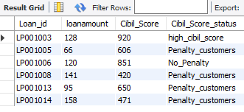
OUTPUT:- delete from loan_cibil_score_status_details where loanamount="loan still processing”; alter table loan_cibil_score_status_details modify loanamount int; select * from loan_cibil_score_status_details;

Slide 12
Monthly interest percentage
Criteria:-
Applicant income <5000 rural=3%
Applicant income <5000 semi rural=3.5%
Applicant income <5000 urban=5%
Applicant income <5000 semi urban= 2.5%
Otherwise =7%
New field creation based on interest
Calculate monthly interest amt and annual interest amt based on loan amt
Create all the above fields as a table
Table name - customer interest analysis(create this into a new table and connect with sheet 2 (loan status) bring the output)

Slide 13
monthly interest
Select c.Loan_ID,c.Customer_ID,c.ApplicantIncome,c.CoapplicantIncome,
c.Property_Area,c.Loan_Status,l.loanamount,l.loan_amount_term,
l.cibil_score,
Case when c.applicantincome<5000 and c.Property_Area="rural" then concat(((loanamount))*0.03)
when c.applicantincome<5000 and c.Property_Area="semirural" then concat(((loanamount))*0.035)
when c.applicantincome<5000 and c.Property_Area="urban" then concat(((loanamount))*0.05)
when c.applicantincome<5000 and c.Property_Area="semiurban" then concat(((loanamount))*0.025)
end as monthly_interest from customer_income_status c join loan_status_imported l on c.loan_id=l.loan_id;

Slide 14
annual interest:-
select c.Loan_ID,c.Customer_ID,c.ApplicantIncome,c.CoapplicantIncome,
c.Property_Area,c.Loan_Status,l.loanamount,l.loan_amount_term,l.cibil_score,
Case when c.applicantincome<5000 and c.Property_Area="rural" then ((loanamount)*0.03)*12
when c.applicantincome<5000 and c.Property_Area="semirural" then ((loanamount)*0.035)*12
when c.applicantincome<5000 and c.Property_Area="urban" then ((loanamount)*0.05)*12
when c.applicantincome<5000 and c.Property_Area="semiurban" then ((loanamount)*0.025)*12
end as annual_interest
from customer_income_status c join loan_status_imported l on c.loan_id=l.loan_id;

Slide 15
Table name - customer interest analysis create this into a new table and connect with sheet 2 (loan status) bring the output) QUERY:-
select c.Loan_ID,c.Customer_ID,c.ApplicantIncome,c.CoapplicantIncome,c.Property_Area,
c.Loan_Status,l.loanamount,l.loan_amount_term,l.cibil_score,
Case when c.applicantincome<5000 and c.Property_Area="rural" then concat(((loanamount))*0.03)
when c.applicantincome<5000 and c.Property_Area="semirural" then concat(((loanamount))*0.035)
when c.applicantincome<5000 and c.Property_Area="urban" then concat(((loanamount))*0.05)
when c.applicantincome<5000 and c.Property_Area="semiurban" then concat(((loanamount))*0.025)
end as monthly_interest,
Case when c.applicantincome<5000 and c.Property_Area="rural" then ((loanamount)*0.03)*12
when c.applicantincome<5000 and c.Property_Area="semirural" then ((loanamount)*0.035)*12
when c.applicantincome<5000 and c.Property_Area="urban" then ((loanamount)*0.05)*12
when c.applicantincome<5000 and c.Property_Area="semiurban" then ((loanamount)*0.025)*12
end as annual_interest
from customer_income_status c join loan_status_imported l on c.loan_id=l.loan_id ;

Slide 16
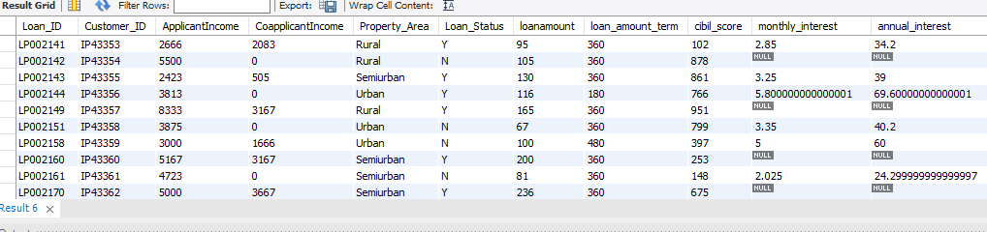
OUTPUT:-

Slide 17

Sheet 3 - customer info:-
Import the table
Update gender based on customer id :-
update customer_info set age=45 where customer_id='ip43007';
update customer_info set age=32 where customer_id='ip43009';
select customer_id,age from customer_info
where customer_id in ( 'ip43007', 'ip43009');

Slide 18
Update gender based on customer id
update customer_info set gender="female" where customer_id='ip43006';
update customer_info set gender="female" where customer_id='ip43016';
update customer_info set gender="male" where customer_id='ip43018';
update customer_info set gender="male" where customer_id='ip43038';
update customer_info set gender="female" where customer_id='ip43508';
update customer_info set gender="female" where customer_id='ip43577';
update customer_info set gender="female" where customer_id='ip43589';
update customer_info set gender="female" where customer_id='ip43593';
select customer_id,gender from customer_info where customer_id in('IP43006','IP43016','IP43018','IP43038','IP43508','IP43577',
'IP43589','IP43593');

Slide 19
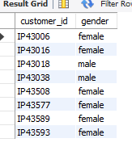
OUTPUT:-

Slide 20
Sheet 4 and 5- country state and region Import the table
Join all the 5 tables without repeating the fields - output 1
select c.Loan_id,c.Customer_ID,c.ApplicantIncome,c.CoapplicantIncome,
c.Property_Area,c.Loan_Status,l.LoanAmount,l.Loan_Amount_Term,
l.Cibil_Score,i.Customer_name,i.Gender,i.Age,i.Married,i.Education,
i.Self_Employed,i.Region_id,s.Postal_Code,s.Segment,s.State,r.Region
from customer_income_status c inner join
(loan_status_imported l, customer_info i,country_state s) on (c.customer_id,c.customer_id,c.customer_id)=(l.customer_id,i.customer_id,
s.Customer_id)
inner join region_info r on s.region_id=r.region_id;

Slide 21
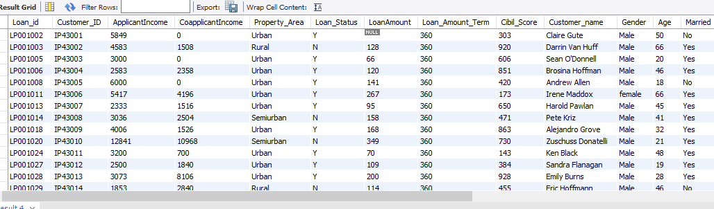
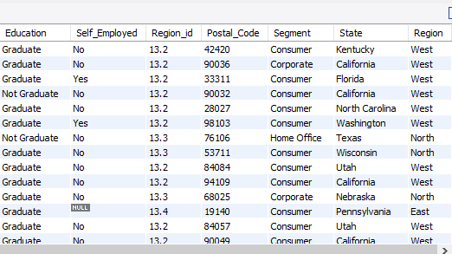
OUTPUT:-

Slide 22
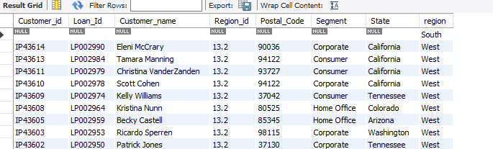
find the mismatch details using joins - output 2:-
QUERY:-
select c.Customer_id,c.Loan_Id,c.Customer_name,c.Region_id,c.Postal_Code,
c.Segment,c.State,r.region from country_state c right join region_info r
on c.region_id=r.region_id;
OUTPUT:-

Slide 23
Filtering information using inner join
Filter high cibil score - output 3
Select c.Loan_id,c.Customer_ID,c.ApplicantIncome,c.CoapplicantIncome,
c.Property_Area,c.Loan_Status,l.LoanAmount,l.Loan_Amount_Term,l.Cibil_Score,
i.Customer_name,i.Gender,i.Age,i.Married,i.Education,i.Self_Employed,i.Region_id,
s.Postal_Code,s.Segment,s.State,r.Region from customer_income_status c
inner join (loan_status_imported l, customer_info i,country_state s) on (c.customer_id,c.customer_id,c.customer_id)=(l.customer_id,i.customer_id,s.Customer_id) inner join region_info r on s.region_id=r.region_id order by cibil_score desc limit 1;

Slide 24
OUTPUT:-

Slide 25
Filter home office and corporate - output 4
select c.Loan_id,c.Customer_ID,c.ApplicantIncome,c.CoapplicantIncome,c.Property_Area,
c.Loan_Status,l.LoanAmount,l.Loan_Amount_Term,l.Cibil_Score,i.Customer_name,
i.Gender,i.Age,i.Married,i.Education,i.Self_Employed,i.Region_id,s.Postal_Code,
s.Segment,s.State,r.Region from customer_income_status c
inner join (loan_status_imported l, customer_info i,country_state s) on (c.customer_id,c.customer_id,c.customer_id)=(l.customer_id,i.customer_id,s.Customer_id) inner join region_info r on s.region_id=r.region_id
where s.segment in ("home office", "corporate");

Slide 26
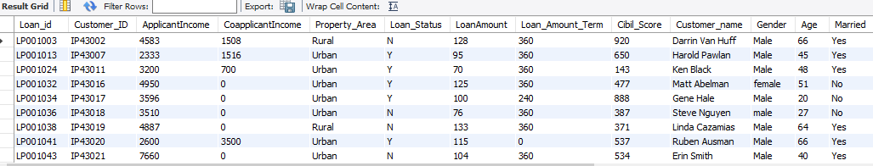
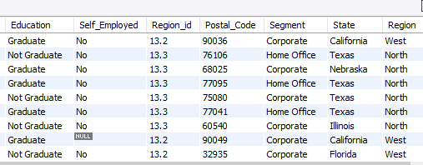
OUTPUT:-

Slide 27
Store all the outputs as procedure:-
QUERY:-
delimiter !!
create procedure sp_outputs()
Begin
select c.Loan_id,c.Customer_ID,c.ApplicantIncome,c.CoapplicantIncome,
c.Property_Area,c.Loan_Status,l.LoanAmount,l.Loan_Amount_Term,l.Cibil_Score,
i.Customer_name,i.Gender,i.Age,i.Married,i.Education,i.Self_Employed,i.Region_id,
s.Postal_Code,s.Segment,s.State,r.Region from customer_income_status c
inner join (loan_status_imported l, customer_info i,country_state s) on (c.customer_id,c.customer_id,c.customer_id)=(l.customer_id,i.customer_id,s.Customer_id) inner join region_info r on s.region_id=r.region_id;select c.Customer_id,c.Loan_Id,c.Customer_name,c.Region_id,c.Postal_Code,c.Segment,c.State,
r.region from country_state c right join region_info r on c.region_id=r.region_id;

Slide 28
select c.Loan_id,c.Customer_ID,c.ApplicantIncome,c.CoapplicantIncome,
c.Property_Area,c.Loan_Status,l.LoanAmount,l.Loan_Amount_Term,l.Cibil_Score,
i.Customer_name,i.Gender,i.Age,i.Married,i.Education,i.Self_Employed,i.Region_id,
s.Postal_Code,s.Segment,s.State,r.Region from customer_income_status c
inner join (loan_status_imported l, customer_info i,country_state s) on (c.customer_id,c.customer_id,c.customer_id)=(l.customer_id,i.customer_id,s.Customer_id) inner join region_info r on s.region_id=r.region_id
order by cibil_score desc limit 1;
select c.Loan_id,c.Customer_ID,c.ApplicantIncome,c.CoapplicantIncome,
c.Property_Area,c.Loan_Status,l.LoanAmount,l.Loan_Amount_Term,l.Cibil_Score,
i.Customer_name,i.Gender,i.Age,i.Married,i.Education,i.Self_Employed,i.Region_id,s.Postal_Code,s.Segment,s.State,r.Region from customer_income_status c
inner join (loan_status_imported l, customer_info i,country_state s) on (c.customer_id,c.customer_id,c.customer_id)=(l.customer_id,i.customer_id,s.Customer_id) inner join region_info r on s.region_id=r.region_id
where s.segment in ("home office", "corporate");
end !!
exec stored_outputs;
delimiter ;

Slide 29
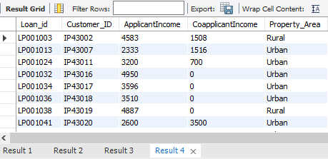
OUTPUT:-
We can find all the 4 results using Stored Procedure in the below image.

Slide 30
Thank you

